Slide 1









How to write a scientific paper?
What are “h-index” and “i10-index”?
www.agrimetsoft.com
https://youtube.com/AgriMetSoft/

Slide 2
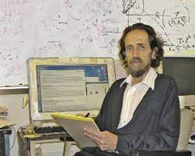
What is “h-index”?
Jorge E. Hirsch in 2005
”h-index” is used to determine the research impact of an individual researcher.
How would you compare the impact of two scientists in a field?
How do you measure how good you are as a scientist?
It weighs and ranks the impact of the researcher, not necessarily the impact of any particular research publication
2
Notes:
The index was suggested in 2005 by Jorge E. Hirsch, Jorge E. Hirsch. Professor of physics. Department of Physics, University of California, San
This is a way of gauging the productivity of a researcher.
A citation means that some other researcher has referenced your work as become useful in his or her research.
How do you measure how good you are as a scientist?
How would you compare the impact of two scientists in a field?
What if you had to decide which one would get a grant? One method is the h-index,
Researchers use different metrics to measure the quality of the published papers in journals.
Through research metrics, one can monitor and quantify the published articles.

Slide 3
Why the “h-index” is important?
author-level metric
productivity
citation impact
Combines an assessment of both quantity and an approximation of quality.
It helps in increasing the impact of the research work.
fellowships, gaining job opportunities, grants across the world.
Metrics are important.
3
Notes:
The h-index is an author-level metric that measures both the productivity and citation impact of the publications, initially used for an individual scientist or scholar.
The h-index thus combines an assessment of both quantity (number of papers) and an approximation of quality (impact, or citations to these papers). is another way to help gauge the productivity of a scholar
The h-index offers a useful (and simple) way to compare researchers who are at similar stages in their careers. Every researcher should produce a good research work in order to get the good h index value
It helps in increasing the impact of the research work. These metrics help in measuring how much a researcher article is cited by the co-researchers
Finally, it is essential to know that competition for academic jobs, particularly postdocs, is very high and challenging. As a result, researchers can obtain scholarships, fellowships, scientific positions, and job opportunities worldwide according to their resumes and scientific metrics. Therefore, the h-index can show the ranking of scholars applying for a position. . Researchers can use these metrics for achieving various fellowships and scholarships, gaining job opportunities across the world.

Slide 4
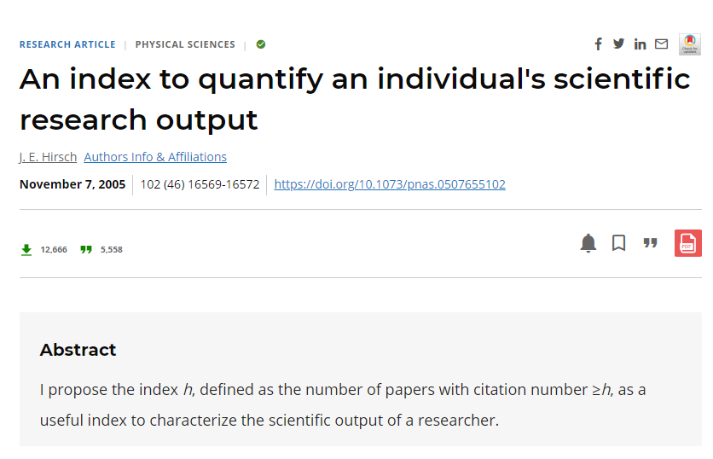
How do we calculate the “h-index”?
n articles have at least n citations each.
4

Slide 5


How do we calculate the “h-index”?
Publications | Number of citations
A | 5
B | 8
C | 2
D | 4
E | 1
h-index=3
8, 5, 4, 2, 1
 This author's h-index is 3, because the author has 3 publications with at least 3 or more citations.
5
Notes:
A h-index of 12 means that an academic has published at least 12 papers that have received at least 12 citations each.
For example, if an author has five publications, with 8, 5, 4, 2, and 1 citations (ordered from greatest to least), then the author's h-index is 3, because the author has 3 publications with 3 or more citations.
It weighs and ranks the impact of the researcher, not necessarily the impact of any particular research publication.

Slide 6
How do we calculate the “h-index”?
f(A)=5,
f(B)= 3,
f(C)=25,
f(D)=4,
f(E)=8,
f(E)=2,
25, 8, 5, 4, 3, 2
h-index=4
 This author's h-index is 4, because the author has 4 publications with at least 4 or more citations.
6
Notes:
If we have the function f ordered in decreasing order from the largest value to the lowest one, we can compute the h-index as follows:
f(A)=10, f(B)=8, f(C)=5, f(D)=4, f(E)=3 → h-index=4 f(A)=25, f(B)=8, f(C)=5, f(D)=3, f(E)=3 → h-index=3
(ordered from greatest to least), then the author's h-index is 3, because the author has 3 publications with 3 or more citations.

Slide 7

How do I find my h-index score?
Google Scholar
1
Web of Science
2
Scopus
3
7

Slide 8

What is “i10-index”?
Google Scholar
”i10-index” the number of publications with at least 10 citations.
Very simple and straightforward to calculate.
8
Notes:
From July 2011 Google have provided an automatically calculated h-index and i10-index within their own Google Scholar profile.
This very simple measure is only used by Google Scholar, and is another way to help gauge the productivity of a scholar.
It is not widely used at universities.

Slide 9

How do we calculate the “i10-index”?
f(A)=5,
f(B)= 10,
f(C)=13,
f(D)=11,
f(E)=8,
f(E)=10,
i10-index=4
13, 11, 10, 10, 8, 5
9
Notes:
For example, if an author/researcher’s i-10 index is 6, it indicates that six of his/her publications are cited 10 times

Slide 10

A single number can never give more than a rough approximation
many other factors should be considered in combination in evaluating an individual.
lot of citations on only one or two papers
will not give you a high h-index.
 Having a few publications well-remarked by colleagues better than having a long list of publications cited poorly.
Tips
H-index
Does not take into account the number of authors on a paper
a researcher was the only author on a paper or one of a large group.
 After 20 years of research, an h-index of 20 is good, 40 is outstanding, and 60 is exceptional.
It matches the number of years a scholar has been working
It is calculated by dividing a scientist’s h-index by the number of years that have passed since the first publication, with a score of 1 being very good, 2 being outstanding and 3 truly exceptional.
It does not tell you about the science or ideas
it tells you nothing about the science or ideas behind a researcher’s achievements.
10
Notes:
Having a few publications that have been well-remarked by colleagues in the field (i.e. they are cited often) is better than having a long list of publications cited poorly, or not at all.
1-Hirsch himself writes: Obviously a single number can never give more than a rough approximation to an individual’s multifaceted profile, and many other factors should be considered in combination in evaluating an individual.
2- getting a lot of citations on only one or two papers will not give you a high h-index. For example, if you have an h-index of 7, it means that you have published 7 papers, each of which has been cited at least 7 times. If you are a “one-hit wonder”, with only one paper that has a lot of citations, this will be shown in a low h-index.
3-It does not tell you whether a researcher was the only author on a paper or one of a large group.
4-h-index that matches the number of years a scholar has been working in the field is a respectable score. Hirsch in fact suggested that the h-index be used in conjunction with a scholar’s active research time to arrive at what is known as Hirsch’s individual m. It is calculated by dividing a scientist’s h-index by the number of years that have passed since the first publication, with a score of 1 being very good indeed, 2 being outstanding and 3 truly exceptional. Hirsch's reviews and checks mentioned that after 20 years of research, an h-index of 20 is good, 40 is outstanding, and 60 is exceptional.
a big drawback of the h-index is that it tells you nothing about the science or ideas behind a researcher’s achievements.
As with all metrics, however, the h-index is subject to a number of biases and limitations, so there are significant problems associated with relying solely on h-index scores when making important research and career decisions.

Slide 11



How can I increase my h-index?
Work on your writing
Choose journal carefully, OA
Quality and innovation
Network
Collaborate
Social media
11
Notes:
Boosting Your H-Index
There are, of course, many different ways to answer these questions. Most readers will find your article with a search engine.
1- Select proper keywords, search engine --→(see the keywords video)
2-
3- Collaborate with more mature researchers (For example, you might get a group of researchers who often cite each other’s work simply to increase their h-index. It is not good) Research has shown that papers with famous first authors get more citations. So, if you are just starting out, try to collaborate with the most experienced researchers in your field.
4-Choose your journal carefully (Publish Open Access) Publications in a journal with a high impact factor are considered to be the most prestigious.
Show up on social media. Well-known, established journals get more readers, which leads to more citations. Try to think about which journal to aim for early in the research process.
Publish Open Access. As you might expect, open access journals get more citations. However, whether you choose open access partly depends on your field.
5- Network, network, network. Attend conferences and meetings whenever you can. This will help you to promote your work and find new collaborators.
6- think about writing a blog about your work. Being present on social media will help to make other researchers aware of you and your work. It will also help you to connect with others in your field.

Slide 12

Review your understanding
https://scholar.google.com/citations?user=jM-FP5AAAAAJ&hl=en
12

Slide 13




Please subscribe to our channel (https://youtube.com/AgriMetSoft/)
Like & do not forget to share it!!
Put your comments and questions below the video.
www.agrimetsoft.com
https://youtube.com/AgriMetSoft/
Notes:
Please hit the thumbs up button and don’t forget to subscribe !

